Slide 1
Sociology #3
Jeniffer Mohammed
3rd October 2018

Slide 2
Week 1: Becoming Teacher
The Sociological Perspectives
MACRO- SOCIOLOGY
Functionalism
Conflict Theory/ Marxism
MICRO-SOCIOLOGY
Interactionist / Interpretive Theory

Slide 3
MACRO-SOCIOLOGY

Slide 4
FUNCTIONALISM
Oldest perspective in Sociology. Focus on order and stability in society.
Views society as a system (the social system) with parts (e.g. social institutions) and each part has a role to play to keep balance or equilibrium.
The society is held together by consensus
The relationships between the ‘parts’ of the system explain social life, social structure – e..g. roles, the distribution of power, wealth, prestige, education, etc.

Slide 5
View of Society from a Functionalist Perspective

Slide 6
FUNCTIONALISM cont’d
Philosophy: Positivism. Reality is ‘out there’ and can be measured and empirically verified; objective, neutral, orderly, systematic
Paradigm – the scientific method, quantitative research methods, surveys, and quasi-experimental designs

Slide 7
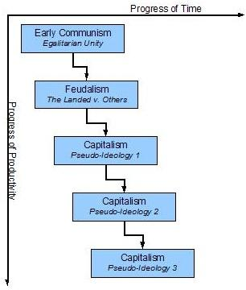
Conflict Theory /Marxism
The society is shaped by Conflict and Contradiction which emanate from the substructure (economy) in capitalist society.
A materialist view of social relations, of society.

Slide 8
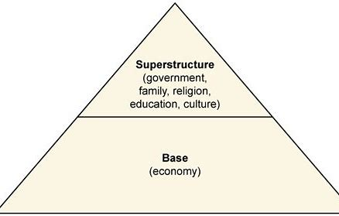
Conflict Theory /Marxism
The social relationships arising from the base (substructure) are legitimised and strengthened by the superstructure.
The superstructure (other social institutions) reflect the ideas and status of the wealthy – the elites.
This sets the scene for social class oppression and domination.

Slide 9
Conflict Theory /Marxism cont’d
Philosophy – Dialectical Materialism (Reality is about change – dominant ideas in every age struggle with new ideas which are gradually supplanted transforming the economic base). Reality is organized according to the social relations of production; it is not neutral. The order is one of social control.
Paradigm – analysis of historical documents, surveys, both quantitative and qualitative analysis. Any problem or issue is examined in relation to power, oppression, inequality, etc. It is not neutral in what it seeks to investigate.

Slide 10
MICRO-SOCIOLOGY

Slide 11
INTERPRETIVE/ INTERACTIONIST PERSPECTIVE –
Social life can best be understood through the relationships of small groups; the agency of individuals is more important in explaining social action than structures; there is no ‘objective’ reality but a ‘subjective’ understanding of social life that needs to be understood.
Philosophy – Hermeneutics: how people make meaning and how they communicate shows how they interpret the world. We cannot tell what something means just by the thing itself but by the thing in context. This makes ‘meaning’ not a fixed or predictable entity. Reality then is socially constructed through interaction.
Paradigm – ethnography, participant-observation, conversational interviews, narratives, life histories, biography, case studies, phenomenology

Slide 12
The Sociological Perspectives
Macrosociology
Microsociology
Functionalism
Society is essentially orderly and stable through norms, roles and, shared values.
Any dysfunctions can be fixed and the system adjusted.
Social institutions interact in ways to bring about the greatest good for all.
Socialization is key in bringing about consensus.
Conflict Theory/ Marxism
Social groups are in conflict because of the dominance of the sub-structure and how it influences the superstructure.
The wealthy/elites seek to preserve their status through oppressive measures (labour).
Socialization – learning the norms of your own social class
Interpretive or Interactionist
Macrosociology can only explain social life at the level of the system.
Social action by individuals and small groups cannot be fully explained by how social institutions interact.
Agency, how persons construct their reality and how they make meaning.
Socialization – actively co-constructed.

Slide 13
Becoming Teacher – Teaching and Teachers’ Lives through the Sociological Perspectives

Slide 14
Sociological Perspectives & Teaching/ Teachers’ Lives
Functionalism
The Historical Context
Teachers play a well defined role in society
There is consensus as to that role
Teachers’ function is to initiate new members of society into the behaviours, skills and knowledge that they need
Teachers’ role is therefore an extension of parents’ role in the socialization of the young
Obeying the status quo is an important rule for teachers
Society rewards teachers with respect for their dedication and altruism
If teachers go against these beliefs/values about teaching then there will be disorder in society and disruption of the system
These tend to be dominant beliefs in the society about teachers and their work. As such, they constitute a body of myths and metaphors with which a person who is becoming teacher must struggle.
Primary System
1838 - Negro Education Grant; Mico Charity
‘Elementary’ education – (not ‘primary’). There were Denominational and State elementary schools
Who becomes an elementary school teacher?
Functionalist Explanations: Social order, teaching as ‘rescuing’ and ‘civilizing’ in itself; teaching as its own reward; for the good of children; a means of social mobility
Marxist Explanations: Need to Anglicize the colony; the ‘missionary’ ideology served the elites; ‘false consciousness’

Slide 15
Sociology Workshop
Statement: “The education system in Trinidad & Tobago can be improved by paying more attention to the professional development of teachers”.
Activity: How might YOU as an adherent of a particular
sociological perspective respond to such a statement?

