Slide 1
Inclusive Education Introduction to Students with Special Needs
Post Graduate Diploma in Education
The University of the West Indies, School of Education
Presenter: Nadia Laptiste-Francis (M.Ed.)
Coordinator: Elna Carrington-Blaides(Ph.D.)
09.08.18

Slide 2
Topics
Overview
Definition
Categories of Special Needs Students
Continuum of Placements
Prevalence
Causes
Educational Considerations

Slide 3
Overview
Historically, people with disabilities and other marginalized groups have largely been provided for through segregated methods such as residential institutions and special schools. Policy has now shifted towards community and educational inclusion. (Carrington- Blaides, 2013).

Slide 4
Global Mandates
The World Declaration on Education for All, adopted in Jomtien, Thailand (1990), sets out an overall vision: universalizing access to education for all children, youth and adults, and promoting equity.( UNESCO policy guidelines,2009)
World Conference on Special Needs Education (1994) Salamanca, Spain. adopted the principle of inclusive education
Dakar Framework for Action (2000) adopted the World Declaration on Education for All (EFA), re-affirmed the notion of education as a fundamental right and led to the new Millennium Development Goal to provide every girl and boy with primary school education by 2015 (Miske Witt 2008

Slide 5
Regional Trends
The Caribbean Symposium on Inclusive education was held in 2007 as part of the preparations for the 48th International Conference on Education (2008).
The purpose of these meetings was to discuss existing perceptions of inclusive education and to identify best practices for use in its implementation in the context of the Anglophone Caribbean (UNESCO 2009)
The Resultant policy created is known as the Caribbean Education For All Action Plan (2015)

Slide 6
Local Context
In Trinidad and Tobago, the government’s commitment to addressing students with special needs was seen even prior to EFA (1990)
National Survey of Handicapped Children and Youth (Marge 1984).Identified some 27,000 or 16.1% of the school population as having a disability (Marge, 1984).
The Macro –Economic Policy (1989-1995) which called for curriculum changes and increases in the number of technical and vocational teachers

Slide 7
Local Context
Pilgrim Report (1990) which proposed the unification of special education and general education
Education Policy Paper (1993–2003), which exposed a philosophy that underscored the following beliefs:” that every child has an inherent right to an education which will enhance the development of maximum capability regardless of gender, ethnic, economic, social and religious background; that every child has the ability to learn” (Johnstone 2010)

Slide 8
Local Context
Inclusive Education Policy (2009) describes a commitment to Inclusive Education within the context of a seamless education system undergirded by support services to make education “available, accessible, acceptable and adaptable.” (Inclusive Education Policy,2009).
Further initiatives for inclusive education were situated within the MoE’s Seamless Education approach, designed to facilitate all learners who may be marginalized or excluded, such as dropouts, underachievers, students with learning or other disabilities

Slide 9
What is Special Education?
Special Education is education specifically designed for learners who cannot profit maximally from regular education such that they require trained personnel, modifications to curricula, teaching methods, instructional materials and adaptations in facilities and equipment.

Slide 10
What Is Inclusive Education?
Inclusive Education is “ a process of responding to the diversity of needs of all learners through increasing participation in learning, cultures and communities and reducing exclusion within and from education” ( Booth, 1996)

Slide 11
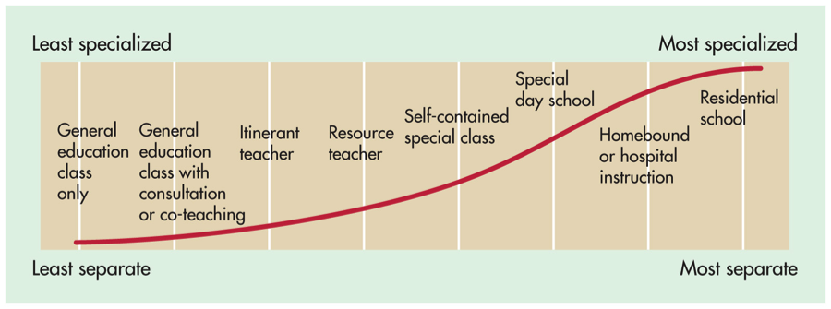
Continuum of placements

Slide 12
Categories of Students with Special Needs
The Student Support Services specified that students targeted for Inclusive Education include ―
dropouts,
students with learning or other disabilities,
students who are gifted and talented,
students infected or affected with HIV,
students with social, emotional, or behavioural difficulties,
ESL students (English for speakers of other languages). (Ministry of Education Student Support Services Division. Understanding Inclusive Education in Trinidad and Tobago)

Slide 13
Definition
Individuals with Disabilities Education Act
(2004) definition: Specific Learning Disability
“Learning Disabilities is a general term that refers to a heterogeneous group of disorders manifested by significant difficulties in the acquisition and use of listening, speaking, reading, writing, reasoning and mathematical abilities. These disorders are intrinsic to the individual, presumed to be due to a central nervous system dysfunction, and may occur across the life span…”

Slide 14
Prevalence
5 to 6 percent of students aged 6 to 17 identified
About half of students identified as needing special education are labeled learning disabled
Prevalence has more than doubled since the 1977 (Over-identification or social-cultural changes)
Boys outnumber girls 3 to 1

Slide 15
Causes
Recent evidence of central nervous system dysfunction
Neuroimaging techniques
Genetic factors
Teratogenic factors
Medical factors
Recent research suggests:
There is also a strong relationship between low socio-economic status (SES) and learning disabilities.
Many factors associated with poverty could be contributing to LD such as:
Little access to health care
Lack of supportive environment
Teachers need to recognize the uncertainty about the causes of LD and keep their expectations high for students.

Slide 16
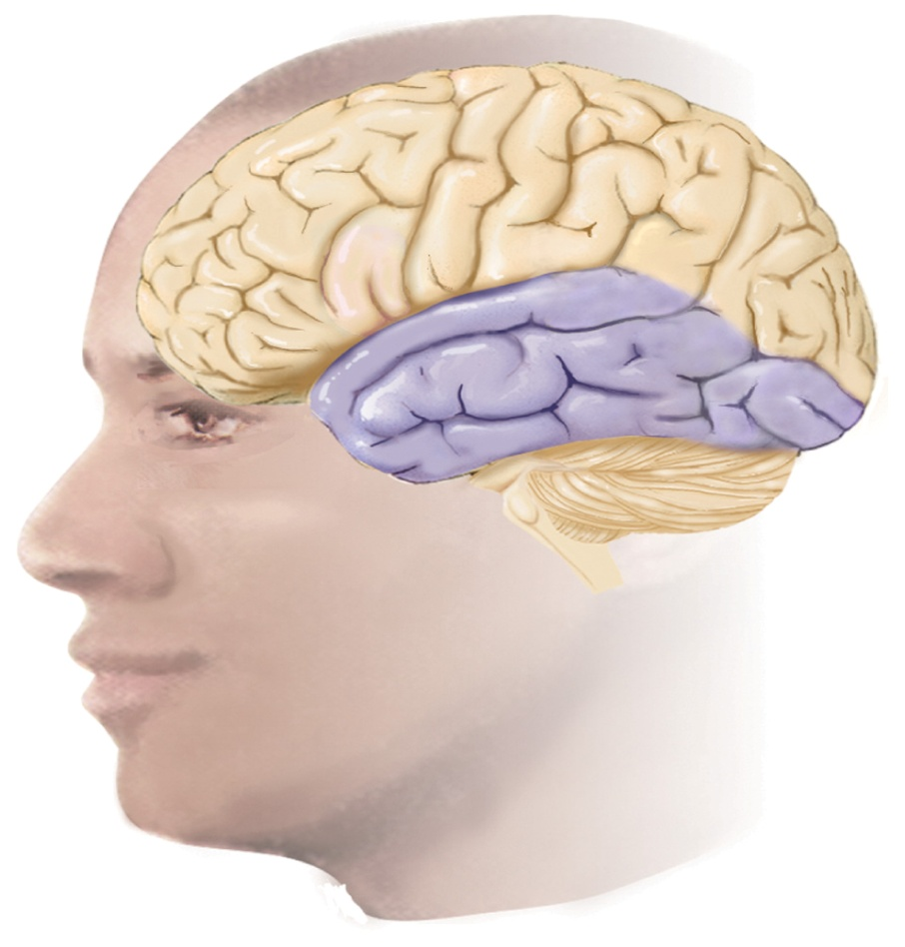
Learning Disabilities and the Brain
The left temporal lobe of the brain and some areas around it are closely associated with reading disabilities.

Slide 17
Timed Activity ( 30 secs)
Read the following out loud:
“ehT kcalb tac tas no eht toh nit foor”

Slide 18
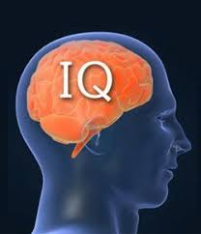
Identification – The Discrepancy Model
Intelligence Tests
Achievement Tests
The discrepancy model compared two norm-referenced test scores:
Aptitude-achievement
Criticisms of the IQ-Achievement discrepancy
Statistically flawed formulas
Difficult and expensive to implement
IQ scores are unreliable and are not strong predictor of reading ability
Unrealistic concept for very young children

Slide 19
Identification – Response to Intervention
A problem-solving approach that involves multiple tiers of increasingly intense, research-based interventions matched to student’s needs.
Three tiered approach
Tier 1, evidence-based instruction
Tier 2, small-group instruction
Tier 3, referred to special education

Slide 20
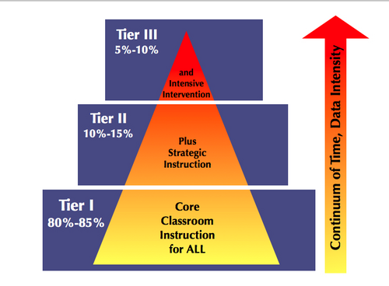
Response to Intervention

Slide 21
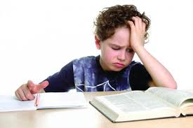
Characteristics – Academic
Academic achievement problems
Reading
Written language
Spoken language
Math
Memory

Slide 22
Socio-emotional and Behavioural Characteristics
Inter-individual variation/ Intra –individual variation
Disorders of attention and hyperactivity
Memory, and metacognitive problems
Social-emotional problems
Nonverbal learning disabilities
Motivational problems
Inactive learner with strategy deficits

Slide 23
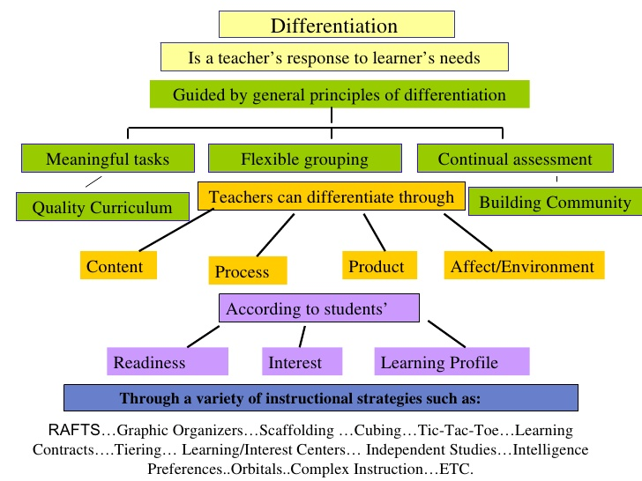
Educational Considerations Differentiated Instruction (Tomlinson, 2014)

Slide 24
Educational Considerations
Differentiated Instruction
Provide visual or graphic organizer
Incorporate models, demonstrations, or role play
Using teacher presentation cues to emphasize key points
Scaffolding key concepts
Involving students by implementing every-pupil response techniques or incorporating manipulatives for students to use.

Slide 25
Universal Design for Learning
Universal Design for Learning (UDL) is promoted as a philosophy, framework, and set of principles for designing and delivering flexible approaches to teaching and learning that address student diversity within the classroom context. ( Capp , 2017)
Universally designed lessons attempt to meet the needs of all learners at the onset of instruction rather than having to retrofit lesson plans that initially fail some learners

Slide 26
Universal Design for Learning
Three Basic Principles of UDL
multiple ways of representing knowledge: designing instructional materials that make content accessible to the greatest number of diverse learners
multiple ways students can demonstrate their understanding: Students are provided with alternative communication methods to demonstrate their learning
multiple ways of engaging students: a range of options for engaging students in the learning process as no single option will work for all students

Slide 27
The MOE Student Support Services Division ( SSSD) Referral Process
Step 1 : Continuous Assessment
Step 2 : Identification of students at risk
Step 3: Data Collection
Step 4: Initial Classroom Intervention
Step 5: Diagnostic Assessment/ Progress Monitoring
Step 6: Consultation with the School Based Team

Slide 28
The MOE Student Support Services Division ( SSSD)Referral Process
Step 7: Implementation of Intervention Strategies
Step 8: Case Review
Step 9: Consultation of Parent/Guardian
Step 10: Referral of Client
Step 11: Team consultation/ Case review
Step 12: Assessment and Intervention
Step 13: Development of Individualized Education Plan ( IEP)
Step 14: Programme Review and Evaluation

Slide 29
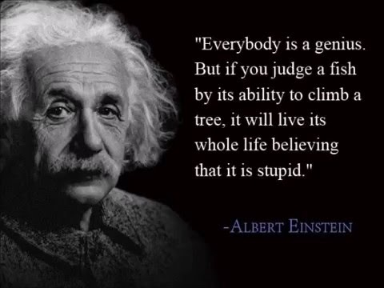
Famous Faces

Slide 30
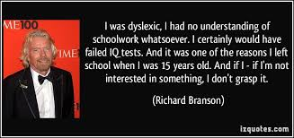
Famous Faces

Slide 31
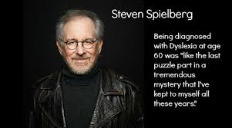
Famous Faces

Slide 32
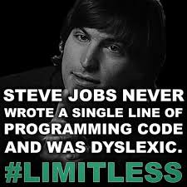
Famous Faces

Slide 33
Food for Thought
All those persons have the gift of Dyslexia.
“Imagine the world today if they believed that they could not do ….”

