Slide 1
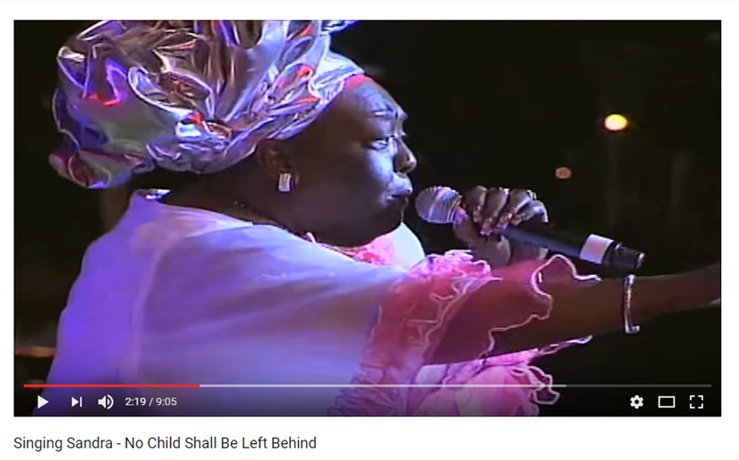
https://www.youtube.com/watch?v=1VCVEBYQPE4
What is Singing Sandra suggesting about our education system?
Notes:
She is suggesting that our education system is not fair to every student. What does she raise? Is their merit to her discourse.

Slide 2
EDFA 5500 Presenter: Rinnelle Lee-Piggott, Ph.D.
Equity in the Provision of Schooling

Slide 3
Objectives
By the end of this session, you will be able to:
Define equity
Consider the degree of equity that exists in T&T’s education system by juxtaposing local occurrences with international practices
Propose solutions for achieving equity in T&T
Notes:
Session is related to: Case 2 & Assignment 3 - options 2 mainly

Slide 4
Consider:
The highest performing education
systems are those that combine
equity with quality.
Notes:
What does this statement mean to you? I don’t want an answer yet. We will revisit this. However, if we were to unpick this, we would want to know ‘What is equity?’ What is quality education?

Slide 5
Understanding EQUITY
Notes:
The best way to understand what equity is for one to consider it alongside the relational conceptions of equality and reality.
What do you make of this?
Everyone is facing a barrier to something exciting that’s happening – good match (which can be considered quality educational opportunities). The hopefuls are very different (they are our students – diverse learners). However, if we hold to principles of equality we (the school; the ministry) will provide the SAME assistance to each student regardless of their needs. But should we hold to principles of equity then we would provide what each person needs in order to access say good schooling/education. That means some people would get nothing, others will get more than others bringing everyone to the same starting point. IS THIS FAIR? What does it mean to be fair or equitable?
Still, the reality that often the most disadvantaged in the first place get nothing, while others get exceptional advantage DOES it exist? Does it exist in T&T?

Slide 6
EQUITY defined
The quality of being fair and impartial
Giving each student access to the resources they need to learn and thrive (Edutopia)
Note:
Adopting principles of equity ensures that equality is realized.

Slide 7
This reality = INEQUITY
How is INEQUITY
evident in our Education
system?
Notes:
Going back to Singing Sandra’s suggestion – How is inequity evident in our education system?

Slide 8
INEQUITY in T&T’s Education System
Placement of primary students with poor scores in secondary schools of seeming lesser quality (World Bank, 2000)
Stratified along the lines of gender, social class, culture and ethnicity (Jules, 1994)
Notes:
Pt 1 - Students with high socio-economic status score significantly higher than their counterparts from low socio-economic backgrounds and are more likely to be placed in the high performing, traditional 5- and 7- year secondary schools
Pt 2 – gender (underperforming boys; girls having limited access to STEM subjects for instance); social class (wealthier usually can pay for private education & lessons to embellish their learning and so go to the ‘better’ schools; culture (do you know that the backgrounds of some students exclude them from decoding the language of school; or their experiences are devalued at school)
These occur at the system level. What does inequity /unfairness look like at the school level?

Slide 9
INEQUITY at the school level
Mismatched curriculum
Insufficient/inappropriate resources
Tracking; selection of form 4/5 subjects
Notes:
Pt 1 – Mismatched curriculum:
caters predominantly to cognitive abilities and discriminates against other learning modalities
is too difficult for most children
(c) Irrelevant to the needs of some students, e.g. the farmer’s children
Pt 2 means that not everybody can benefit from resources; some children would be unable to participate in certain school activities
Pt 3 – tracking into subject streams (previously because a student would have come in from a ‘Junior Sec, they would have been excluded from doing Sciences but tracked into tech Voc areas.)

Slide 10
How does inequity thrive in any education system?
Notes:
According to Bob Marley, there will always be first and second class citizens. - Difference; competition, greed, selfishness… (Discrimination; Exclusion; Marginalization)

Slide 11
*Who is MARGINALIZED?
Children from the poorest and most disadvantaged homes
Girls/Boys
Minorities or non-whites
What other people groups can you think of?
Notes:
*What researchers have come to realize is that certain groups are more likely to be excluded or be treated unfairly, resulting in the generation of terms such as discrimination, exclusion and marginalization.
Which groups? - certain ethnicities; the disabled; migrants; LGBTQIA

Slide 12
Consider in groups:
Why do we need equity in schooling?
What has the government & MOE done to make schooling more equitable in T&T?
What has been done by schools to make them more equitable?
What can be done by schools to make them more equitable?
Notes:
Using the columns in the auditorium - Think about and discuss with the persons close to you Qu 1, 2, 3 or 4 in 7 mins & share

Slide 13
Qu 1 - Why do we need equity in education?
ALL children would experience quality educational opportunities means equal chance of school success
Children would not be penalized for life having failed school
Society would not be imposed with the high costs of school failure
Individual and societal capacities would be strengthened
Source: OECD (2012). Equity and Quality in Education.
Notes:
Pt 1 – For ALL children means we must make provision for (who knows the word?: INCLUSION); Success, regardless of socio-economic status.
Pt 2 – they end up with fewer life prospects:
Work for menial wages,
higher risks of unemployment
more difficulties in adapting to rapidly changing knowledge-based economies (BIR online; applying for visas; banking services)
less likely to take up further learning opportunities (they’ve likely had bad experiences of school)
(e) less able to participate fully in the civic and democratic aspects of modern societies (e.g. who attends public consultations?; who asks questions in PTA meetings?)
Pt 3 – when a child fails school because of inequitable opportunity they:
limit the capacity of their country to produce, grow and (especially) innovate;
Gov’ts have to meet the costs of public health and social development programmes; costs associated with criminality as many of these students may become engaged in ‘at risk’ behaviours – teenage pregnancies, drugs, crime

Slide 14
Qu 2 - T&T’s system response to inequity
Became a signatory to ‘Dakar Framework: Education for all’
Gov’t ECCE provision and regulation
Policy on inclusive education; 10 principles, including:
Equal opportunity; facilitating access
Valuing diversity; participation of parents
Identifying/addressing individual needs; CPD
Developing partnerships
Caribbean Vocational Qualifications (CVQ)

Slide 15
Qu 2 - T&T’s system response to inequity (cont’d)
Centre of Excellence for Teacher Training (CETT) - every teacher, a teacher of reading!
NCSE – qualifications for early school leavers
Policies on teaching, teacher education & teacher recruitment (esp. primary teachers)
Provisions for textbooks, transport & FSM
Improved requirements to select principals

Slide 16
Qu 3 - Towards Equity: School Level
Schools as adding value. How?
Effective/Successful Leadership
compensation for socio-economic disadvantage
School culture:
teacher-student relationships;
home-school links;
building of social and cultural capital
commitment to high expectations
Effective teaching: differentiated instruction; culturally-relevant pedagogy; use of assistive technologies
Notes:
Pt 1 – leadership (responsive to their school’s context; encourages inclusion; set direction that the school needs to go; risk taker); compensating for disadvantage; committed to high expectations rather than holding a deficit belief about students and their families; culture – teacher-student relationships; differentiated instruction, quality teaching

Slide 17
Qu 3 - Towards Equity: School Level
Avoid the reproduction of existing inequities
Eliminate grade/form repetition
Avoid early tracking;
Manage school choice programmes (access to school info; diverse student distribution)
Making academic & vocational tracks equivalent
Notes:
Sub Pt 1 – eliminate grade/form repetition by provide learning support when and where needed

Slide 18
Consider: Is it enough?
How do our efforts compare to international benchmarks of inclusive schooling?

Slide 19
Towards Equity & Equality: OECD
Eliminating system level practices that hinder equity
Making public funding responsive to school & student needs
Targeting low performing disadvantaged schools
Aligning education policies with other government policies, such as housing or welfare
Source: OECD (2012). Equity and Quality in Education.
Are we there yet?
Notes:
Organization for Economic Co-operation and Development
Are we there yet????

Slide 20
Towards Equity & Equality: OECD (cont’d)
Strengthening and supporting school leadership (e.g. selection of principals SfCC)
Equitable distribution of resources
Closing recurrently failing schools
Attracting, supporting & retaining high quality teachers
Source: OECD (2012). Equity and Quality in Education.
Are we there yet?

Slide 21
Take away words/concepts
Equality
Reality
Discrimination
Inequity
Inclusion
multiculturalism
Equity
Fairness
Marginalization
Education for All
https://www.youtube.com/watch?v=1VCVEBYQPE4
Notes:
Let’s apply these key terms to Singing Sandra’s musical discourse

Slide 22
References
OECD (2012). Equity and Quality in Education: Supporting Disadvantaged Students and Schools. OECD Publishing.
Government of Trinidad and Tobago, Ministry of Education. Forty-eighth session of the International Conference on Education (ICE): National Report on the Development of Education in Trinidad and Tobago, 2008. [Online] Available at: http://www.ibe.unesco.org/National_Reports/ICE_2008/trinidadtobago_NR08.pdf
Equity vs. Equality: 6 Steps Toward Equity. Available at: http://www.edutopia.org/blog/equity-vs-equality-shane-safir

