Slide 1
EDCU 2013
Focus
PHILOSOPHY AND CURRICULUM
SHARMILA HARRY
Lecturer

Slide 2
Objectives
To explore core educational philosophies
To identify the philosophy/ies which underpin teaching in your schools
To analyze the philosophies that influence the curriculum
To critically assess their schools’ philosophy
To reflect on your personal teaching philosophy

Slide 3
FOUNDATION ELEMENTS
PHILOSOPHICAL
PSYCHOLOGICAL
HISTORICAL
SOCIO-CULTURAL

Slide 4
The Philosophical Perspective
What should to be taught?
In what ways should things be taught?

Slide 5
The Philosophical Dimensions
The philosophical dimensions of the curriculum are important :
for establishing a rationale for the curricula we have in our schools.
It is also important to seek answers to the following questions when designing, developing and delivering the curriculum:

Slide 6
The Philosophical Perspective
Who should be educated?
Who can be educated?
What kinds of educational experiences should be offered to given groups of learners?
How can our nation afford to spend for education?
Are our schools effective as they used to be? If not, why not?
How can the differential needs of our individual learners be met?

Slide 7
The Role /Function of Philosophy
The base or starting point in curriculum development
Interdependent function with other functions in curriculum development
Essential to any meaningful development activity
Provides educators with a framework for broad issues and tasks, such as the goals of education, the content and its organization, the process of teaching and learning and the experiences to stress

Slide 8
Distinct and more specific philosophies of education exists.

Slide 9
Major Philosophies That Influence Education – (Ornstein & Hunkins, 2004; Doll, 1996)
Idealism
Realism
Pragmatism
Existentialism

Slide 10
MAJOR PHILOSOPHIES
IDEALISM
The highest aim is the search for truth and values that will stand the test of time
PRAGMATISM
DEWEY
Knowledge is a process in which reality is constantly changing
EXISTENIALISM
GREENE
A person creates his/her own definition and thus creates his or her own essence … we are what we choose to be
REALISM-ARISTOLTE Everything is derived from nature and subject to its laws
PLATO

Slide 11
EDUCATIONAL PHILOSOPHY
Crucial
to any meaningful
curriculum development
activity

Slide 12
CORE PHILOSPHIES of EDUCATION
TRADITIONAL
PERENNIALISM
ESSENTIALISM
CONTEMPORARY
PROGRESSIVISM
RECONSTRUCTIONISM

Slide 13
Educational Philosophies
(Ornstein & Hunkins, 2004; Doll, 1993; Dewey, 1938)
(Aspects can be derived from the roots of idealism, realism, pragmatism and existentialism)
Perennialism
Essentialism
Progressivism
Reconstructionism

Slide 14
Traditional
“I am turned into a sort of machine for observing facts and grinding out conclusions.”
(Dawin, Charles R.-1809-1882)

Slide 15
Perennialism (Traditional)
Reality is unchanging
Knowledge is absolute and unchanging and has stood the test of time and valued
Knowledge is attained by recalling ideas
Goal of education is to develop the rational person
Curriculum -one common curriculum, little attempt to adapt curriculum to students’ needs and interests
The teacher and the textbook are the sources of authority in the field of knowledge being attained

Slide 16
Perennialism (Traditional)
Heavily subject-centered
Reject subjects as art, music, physical education and vocational
The student’s mind is regarded as a sponge

Slide 17
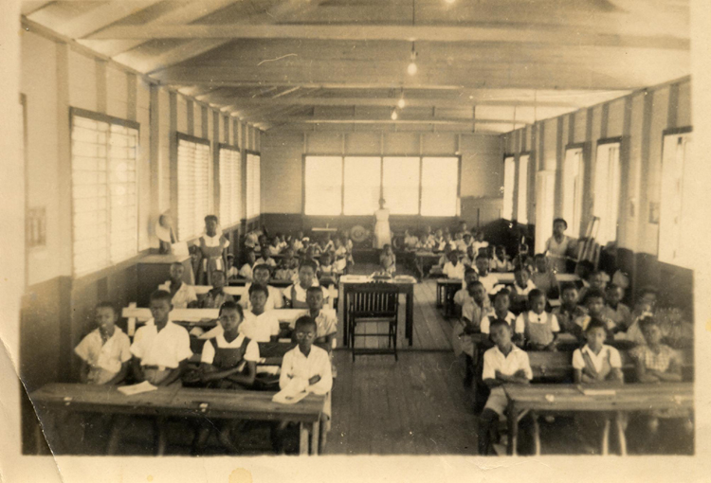
What is Perennialism?
A Perenialist Classroom
Retrieved from: http://www.bing.com/images/search?q=old+timey+classroom+photos&qs=AS&sk=&FORM=QBIR&pq=old%20timey%20
class&sc=1-15&sp=1&qs=AS&sk=#x0y0

Slide 18
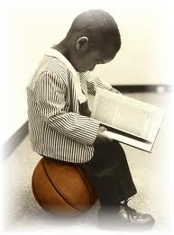
Think about it
x
NO THINKING ALLOWED

Slide 19
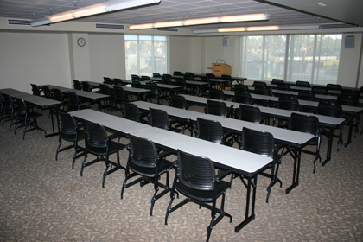
A Perennialist Classroom Layout

Slide 20
The Focus
on the teacher and subject area rather than the learner.
rejects subjects that fosters creativity such as music and art.
on the academic performance of the learner.
on conformity, compliance with authority, knowledge and discipline.

Slide 21
Essentialism (Traditional)
Reality and knowledge – absolute
Students should master the three R’s (reading, writing and arithmetic) at primary level
Require students to absorb transmitted knowledge
Curriculum -one common curriculum regardless of interests and abilities
Teacher as the authority figure and in control of classroom

Slide 22
Progressivism (Non-Traditional)
Reality and knowledge are ever-changing
Knowledge arrived through experience and experimentation
What is good, benefits the individual and society
Curriculum is interdisciplinary (Dewey, 1916)
Book and subject matter not sources of ultimate knowledge but part of the learning process (Dewey, 1916)

Slide 23
Progressivism cont’d
Teacher as guide
Focus on the learner rather than subject – their experience central
Emphasize activities and experiences
Encourage cooperative group – learning activities, not passivity
Use local resources not static aims and materials

Slide 24
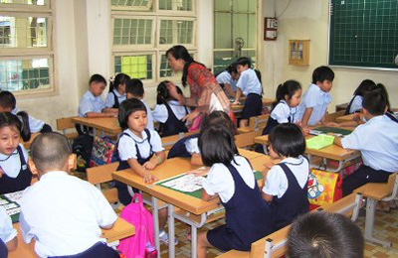
What is Progressivism?

Slide 25
The Focus
Is placed mainly on the learner.
To foster holistic development of the learner.
To encourage active learning.
Is on making learning more meaningful.
Is on building independent learners who are able to think critically.

Slide 26
Social Reconstructionism (Non-Traditional )
Reality is evolving in an evolving society
We must all be involved in the effort to improve the social and cultural context
Focuses on needs of society and those oppressed by it
Value subjects like Social Studies, critical pedagogies, problem solving skills – needed to address society problems
Curriculum based on social issues
Teacher as change agent

Slide 27
RECAP
Traditionalists argue that:
The best approach to schooling is to fill the minds of students with information from a wealth of precious sources in the ancient and modern world;
Liberal studies to be superior to all others;
Curricula should be differentiated to cultivate an intellectual elite;
One should accept the world as it is and then confirm to it

Slide 28
RECAP
Progressivists, on the other hand, believe that:
Learners should be encouraged to take from accumulated human knowledge;
The liberal and the practical arts have equal value;
Widely differentiated curricula help develop the uniqueness of each human being regardless of his or her seeming lack of promise and potential;

Slide 29
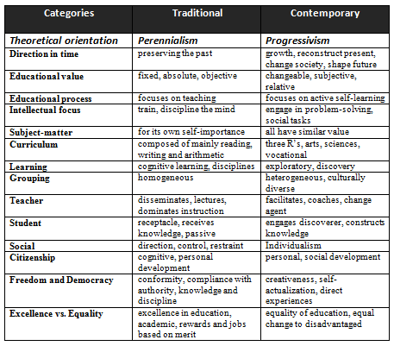
Comparison of Attributes
Figure 1: A comparison of Attributes of Educational Philosophies. Adapted from http://www.readbag.com/,
by L. Ornstien, 2006. Retrieved from October 7, 2012, http://www.readbag.com/hccs-hcc-system-home-departments-tle-
programs-workshop-learning-resources-tle-program-workshop-resources-pdf-files-learner-centered-workshop-
comparison-edu-philo. Copyright 2006. Reprinted with permission.

Slide 30
Expressions of Education Philosophy
Traditional or Contemporary?

Slide 31
Critical Reflection
The Colonial Curriculum

Slide 32
Critical Reflection
You may well
have been educated through a
curriculum
that was
heavily perrenialist
in its philosophy

Slide 33
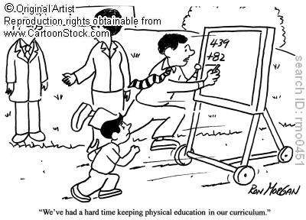

Slide 34
“I am turned into a sort of machine for observing facts and grinding out conclusions.”
(Dawin, Charles R.-1809-1882)

Slide 35
Carl Campbell in Colony and Nation describes the colonial curriculum as
“always bookish” (21)

Slide 36
subjects were studied from only books as opposed to an integration of books, students environmental experiences and interests.

Slide 37
Trivia Game
From the pictures guess whether it is a perennialist or progressivist type of educational system that is fostering the behavior.
State why you made your decision.

Slide 38
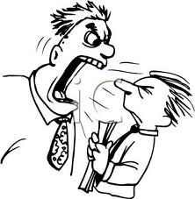

Slide 39
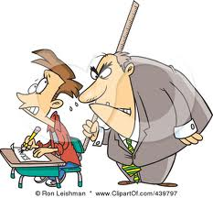

Slide 40

That was an awesome fieldtrip

Slide 41
How
To
Think
NOT
What to Think

Slide 42

Dwayne Bravo showed his class once again with a century in the Hobart Test

Slide 43


Slide 44


Slide 45
Personal Philosophy of Teaching
What is a Philosophy of Teaching?
“a personal set of values in teaching that…represents the important and stable ideas, beliefs, assumptions that affect our behaviours.”
(Fuhrman & Grasha, 1999)

Slide 46
Personal Philosophy of Teaching
What is the Purpose of Articulating a Philosophy of Teaching?
Dictate your perspectives and actions in the learning environment
Impact on the learners in your classroom

Slide 47
Some Components of a Philosophy of Teaching Statement
Teaching strategies so people can envision you in the classroom.
Conception of teaching and learning
Perception of your role as a teacher
Perception of the students’ role
Evidence of these beliefs (activities/behaviours)
Experiences(teaching/childhood/learning ) that fostered these beliefs and- its influence on how and why you teach?
Personal theories developed as a result
Teaching values
Classroom environments you create

Slide 48
Questions pertinent in a teaching philosophy statement
Some questions Chism (1998) suggests are pertinent in a teaching philosophy statement:
How do people learn?
How do I facilitate that learning?
What goals do I have for my students?
Why do I teach the way that I do?
What do I do to implement these ideas about teaching and learning in the classroom?
Are these things working? Do my student meet the goals?
How do I know they are working?
What are my future goals for growth as a teacher?

Slide 49
Excerpts of Teaching Philosophy
Traditional, Contemporary or a Combination?

Slide 50
Using metaphors
Extracts of philosophy statements using Metaphors (Grasha, 1996):
Journey-Guide: “Knowledge is perceived as a perspective on the horizon. The teacher guides students on their journey. Students need to follow a course, .... they will come to the end of their journey.” (p.35)
Master-Disciple: “Knowledge is a skill or habit to be learned. The instructor trains students and the students ideally do what they are told without questioning the master.” (p.35)

Slide 51
CRITICAL THINKING
Reflect on your own Metaphors
  Other metaphors?
  Banker
  Gardener
  Entertainer
  Choreographer
  Tour bus driver with passengers who keep their window curtain closed

Slide 52
Activities
Write your teaching philosophy
Critically evaluate the philosophy/philosophies that influence a curriculum of your choice

Slide 53
Students
Should be taught
HOW TO THINK
NOT
What to think

Slide 54
Thank you

Slide 55
READINGS
Chism, N. V. N. (1998). Developing a philosophy of teaching statement. Essays on Teaching Excellence 9 (3), 1-2. Professional and Organizational Development Network in Higher Education.
Eisner, E. (2002). The Educational Imagination: On the Design and Evaluation of School Programs. (2nd ed.)New York: Macmillan
Grasha, A.F. (1996).Teaching with style: A practical guide to enhancing learning by understanding teaching and learning styles. Pittsburgh, PA: Alliance Publishers.
Jackson P. W. (!996). Handbook of Research on Curriculum. New York: Macmillan.

Slide 56
READINGS
McNergney R. F. and Herbert J. M. (1998). Foundations of Education. (Second Edition)Boston: Allyn and Bacon.
Ornstein A .C. and Hunkins F. P. (2004) .Curriculum Foundations, Principles, and Issues. Boston: Pearson Education, Inc.
Tyler R .W .(1949). Basic Principles of Curriculum and Instruction. Chicago: The University of Chicago Press.

Slide 57
Thank you

